Slide 1

LIME: Making AI Decisions Explainable
Local Interpretable Model-Agnostic Explanations

Slide 2

The Challenge
Black Box Problem
Trust Gap
LIME Solution
Users need to understand predictions to trust them
Reveals which features influence each prediction
AI models make decisions, but we don't know why

Slide 3




How LIME Works
Input Features
Perturb
Load data vector into model
Change one feature at a time
Track Changes
Rank Influence
Log prediction shifts
Order features by impact

Slide 4
Project Objectives
Input Feature Vector
Vary Features
Accept prediction data
Change one value at a time
Log Changes
Rank Influence
Track output shifts
Order by importance

Slide 5
Five Core Modules
01
02
03
Input Feature Loader
Model Simulator
Perturbation Engine
Accepts and normalizes data vector
Returns weighted sum prediction
Modifies one feature at a time
04
05
Change Tracker
Ranker Exporter
Logs prediction differences
Outputs influence order

Slide 6
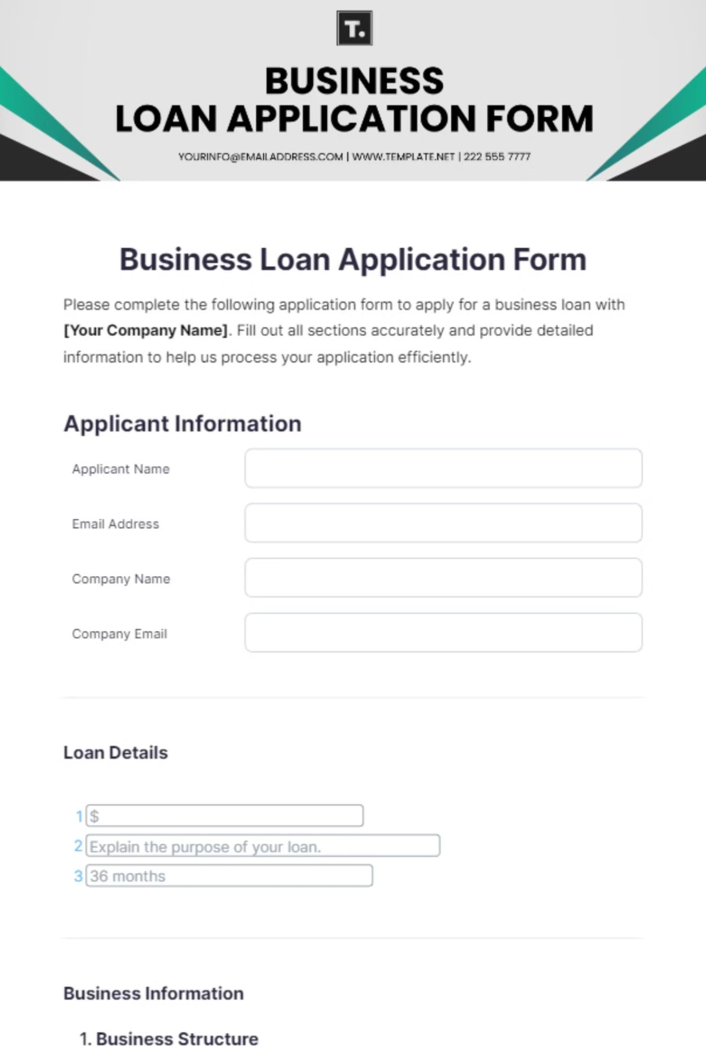
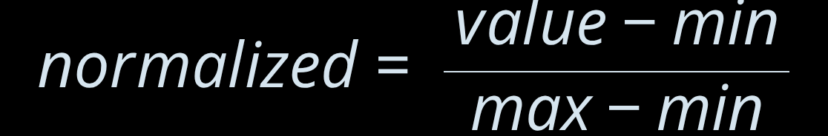
Loan Approval Example
Input Features
Normalization
Age: 18-60
Scale all values between 0 and 1
Salary: ₹10K-₹100K
Credit Score: 300-900
Loan Amount: ₹5K-₹50K
Dependents: 0-5

Slide 7
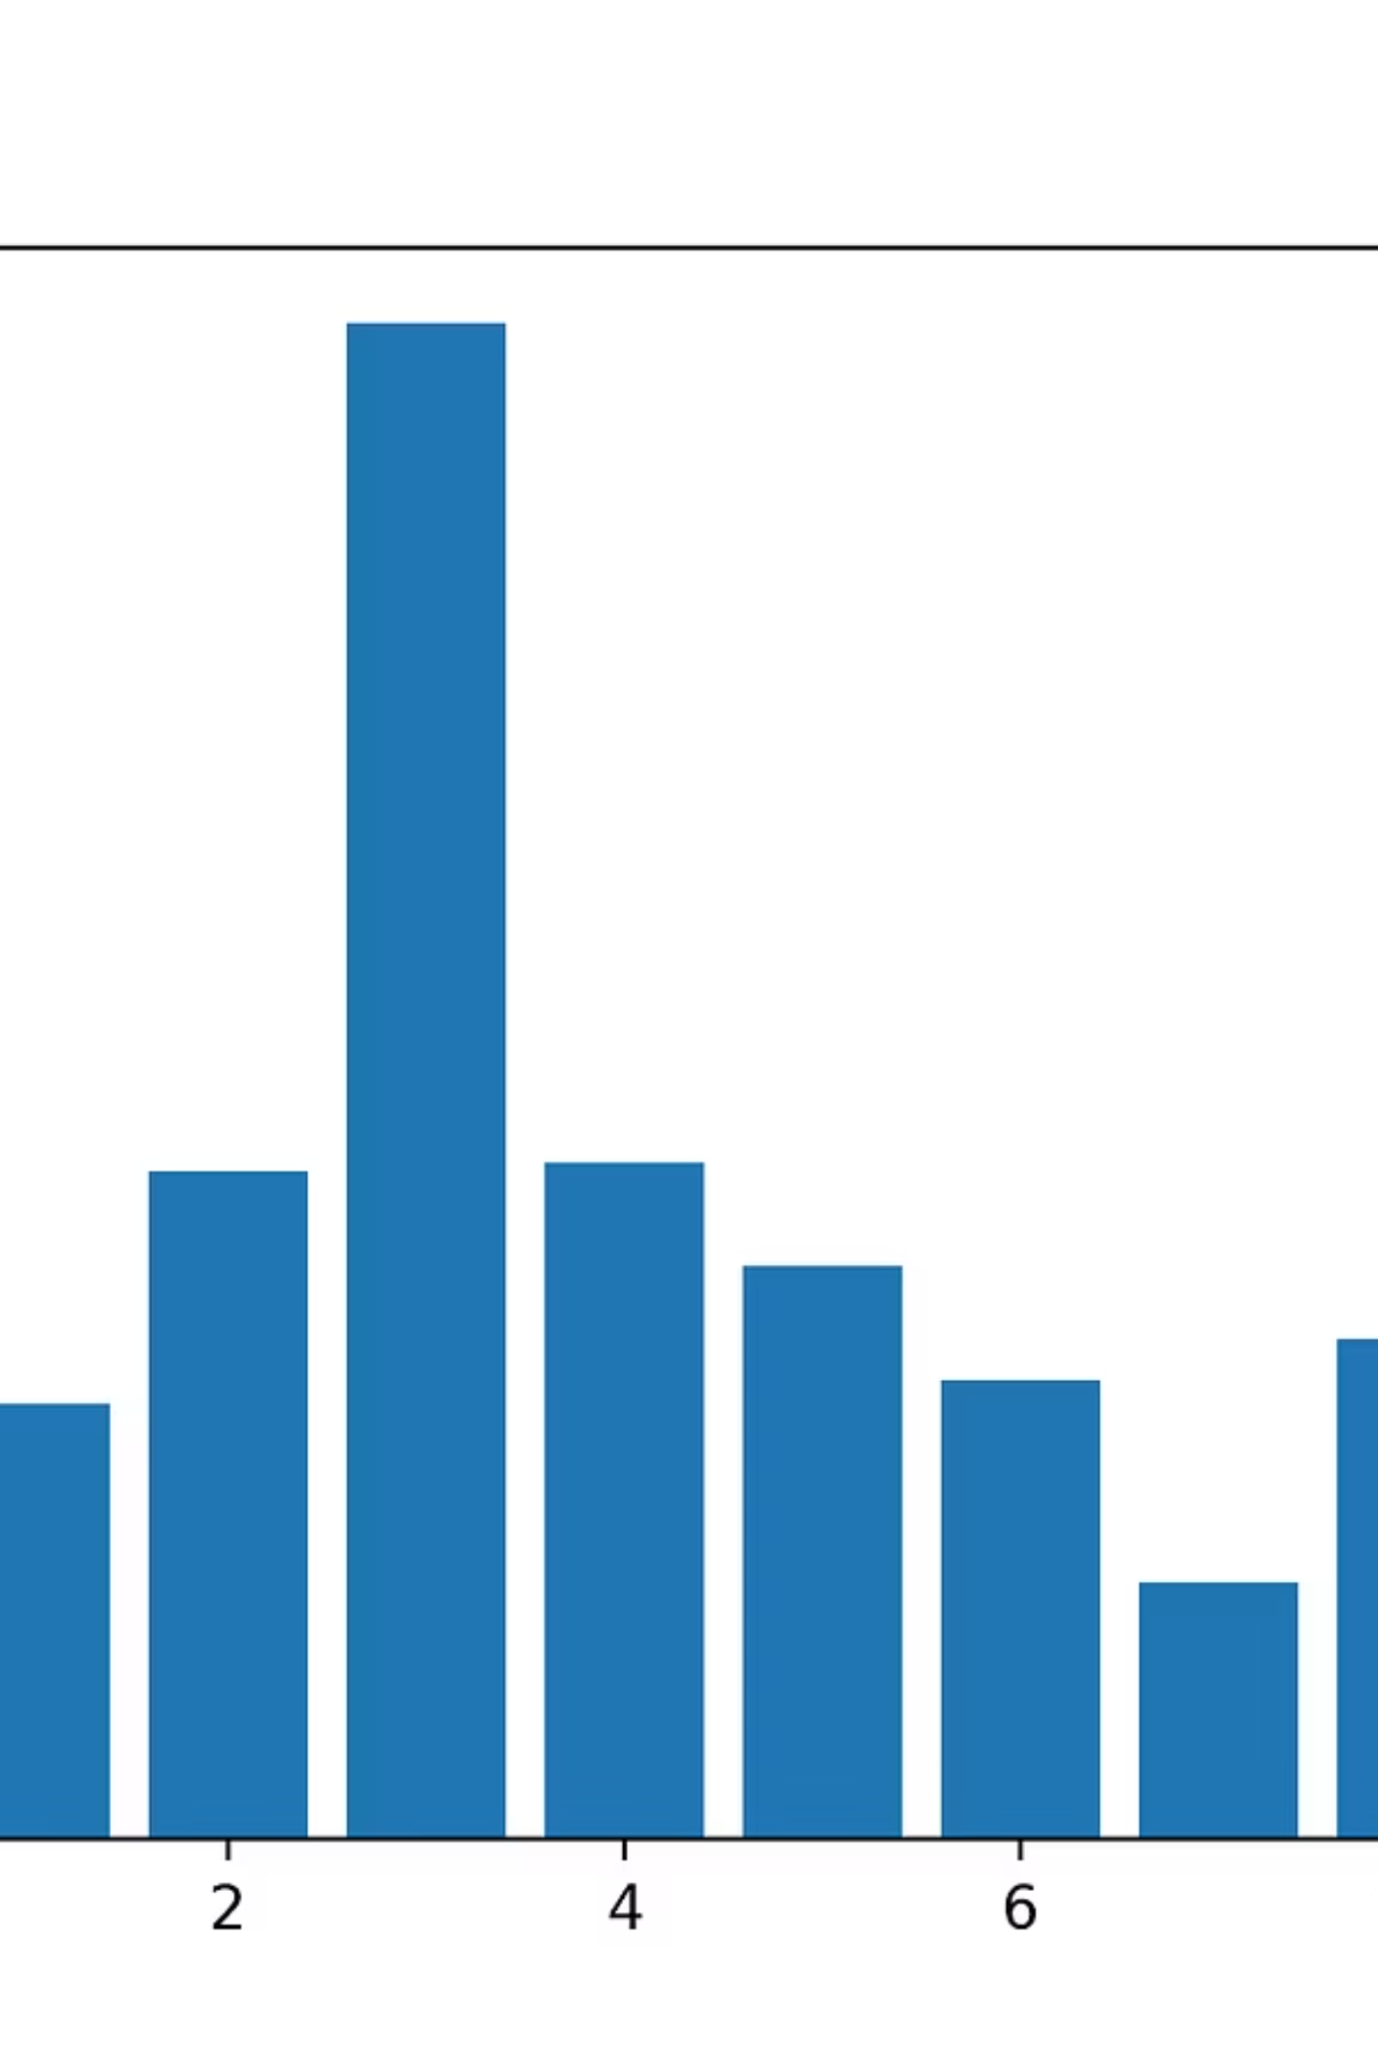
Feature Influence Ranking
1
2
3
Age
Loan Amount
Salary
Highest impact on prediction
Strong influence on decision
Moderate effect
4
Credit Score
Lower relative impact

Slide 8
Real-World Applications
Loan Systems
Medical Diagnosis
HR Analytics
Explains approval factors
Reveals health parameter impact
Highlights selection criteria

Slide 9

Advantages & Limitations
✓ Advantages
⚠ Limitations
Easy-to-understand visualization
Fixed weighted-sum formula
Cannot capture nonlinear patterns
Low computational cost
Builds user trust
Predetermined weights
Domain-agnostic approach
Limited scalability

Slide 10

Key Takeaways
Transparency Matters
Feature Influence
LIME makes AI decisions interpretable and trustworthy
Perturbation reveals which inputs drive predictions
Practical Impact
Applicable across finance, healthcare, and HR domains

